Slide 1
OWL BASED RULE WRITING FOR SEMANTIC WEB CONTENT BASED MULTIMEDIA VIDEO IN CRICKET DOMAIN
USING HADOOP ECO SYSTEM

Slide 2
CONTENTS
INTRODUCTION
MOTIVATION
PROBLEM STATEMENT
OBJECTIVES
LIMITATIONS
LITERATURE SURVEY
APPLICATIONS

Slide 3
INTRODUCTION
There is an increasing need to design efficient methods to semantically annotate video to store, retrieve and manage the information captured in them.
The ultimate goal is to enable users to retrieve some desired content from massive amounts of video data in an efficient and semantically meaningful manner.
The history of artificial intelligence shows that knowledge is critical for intelligent systems. In many cases, better knowledge can be more important for solving a task than better algorithms. To have truly intelligent systems, knowledge needs to be captured, processed, reused, and communicated.
Ontology’s support all these tasks. The term "ontology" can be defined as an explicit specification of conceptualization.

Slide 4
MOTIVATION
With the basic need of data mining that says we are in drowning in data but lacking in knowledge, in text-based applications, it is often sufficient to annotate only the generic properties of the document (metadata) and to perform keyword search, based on full-text information retrieval approaches but for videos content information becomes inevitable, in this regard an important step towards efficient manipulation and retrieval of visual media is semantic information representation.

Slide 5
PROBLEM STATEMENT
OWL based rule writing for semantic web content based multimedia video in CRICKET Domain.
Using Hadoop Eco system

Slide 6
LITERATURE SURVEY
Base Paper
[1] Automatic Semantic Content Extraction in Videos Using a Fuzzy Ontology and RuleBased Model IEEE Transactions on Knowledge and data engineering Vol1 Jan 2013 Yakup Yildirim, Adnan Yazici, Senior Member, IEEE, and Turgay Yilmaz, Student Member, IEEE

Slide 7
OBJECTIVES
Annotation using the Text present in the Cricket video.
Annotation using the Faces present in the Cricket video.
Mapping Low Level Features to Ontology.
Ontology Parser.
Retrieve Videos based on Query given.

Slide 8
LIMITATIONS
Less Accurate Text and Face Recognition.
More features need to be added to Ontology.
Results Retrieved are Un-Ranked.
Queries are not in Natural Language.

Slide 9
REQUIREMENT SPECIFICATIONS
Software Requirements:
Operating System: Windows 7® ultimate (32 bit) , LINUX VMWARE
Hardware Requirements:
Intel® Core™ i3 processor
Hard disk minimum 60GB
4GB RAM

Slide 10
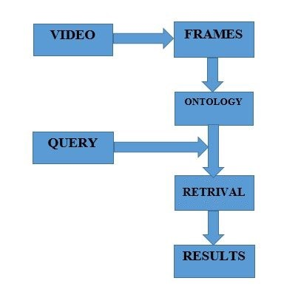
SYSTEM MODEL
System model, as shown below takes video as input and then converts it into frames from which features are extracted and mapped to ontology. The user enters the query to get the ranked results.
Figure : System Model

Slide 11
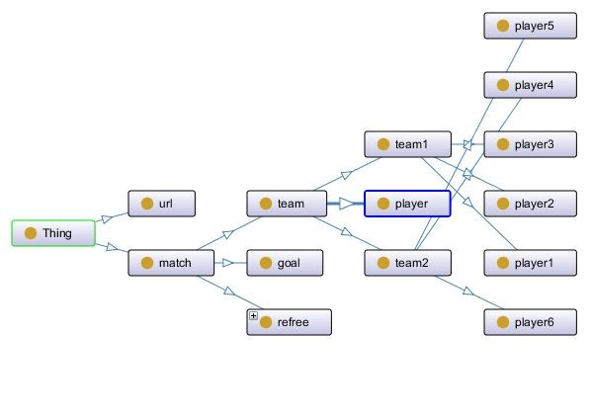
CRICKET ONTOLOGY

Slide 12
IMPLEMENTATION
In Implementation phase we will be coming up with the concepts of
Optical Character recognition
Face Recognition
Mapping Low Level Features to Ontology
Parser

Slide 13
APPLICATIONS
Applications of OWL based Rule Writing system are as follows:
Facilitating the integration of information from mixed sources.
Improving information retrieval thereby reducing information overload.
Identifying relevant information with respect to a given domain.
Providing decision making support.

Slide 14
FUTURE SCOPE
Future work would involve research along two directions:
Increase the efficiency of text recognition and face recognition, Add more features to ontology, apply Fuzzy logic on ontology and Ranked Retrievals of the results.
Query should be extended to Natural language queries, instead of Manchester syntax i.e Boolean query.

